Slide 1
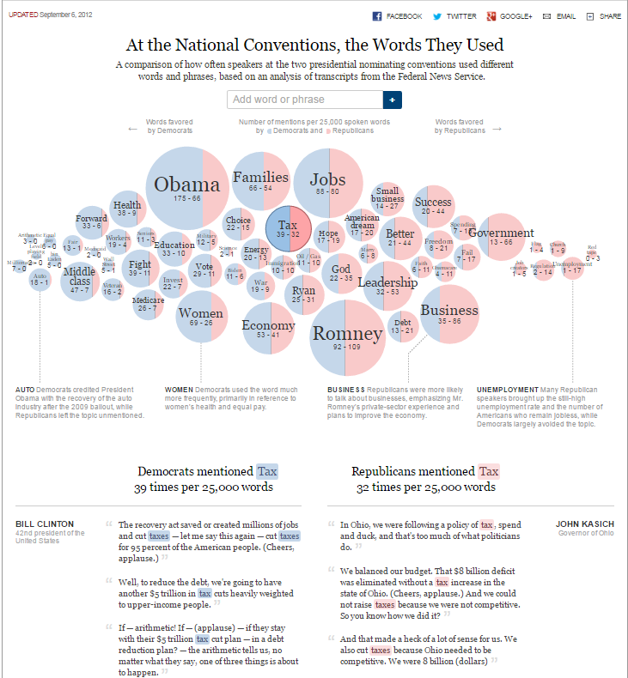
Text Visualizations : Various Ways To Visualize Text
Common Visualization Techniques
Graph Visualization of Documents
Split Bubbles
Plain Text Visualization
Word Cloud
Graph Visualization of Documents of Text
Context Sensitive Narratives
Split Bubbles
In this kind of visualization every document is represented as a node in a force directed graph. Documents which are ”similar” in context are drawn together and the ones that are not are further apart.
Important words across a cluster of nodes can then be shown on represent what that cluster is representing.
Graph visualizations of text documents of large amount of data can cause slowness in rendering visualization in the browser and could be a good option to use server side rendering.
Plain Text Visualization
Displaying numbers as large text is a powerful way to get a readers attention.
Adding color to these text can give the user a sentiment value.
A Simple Word Cloud
Context Sensitive Narratives
Having context sensitive text that changes based on what the reader is looking is a very powerful technique.
This allows the report designer to highlight key elements and correlations that could
otherwise escape the reader while at the same time offer additional content that is specific to the focused area of the visualization.
This visualization displays the result of a word frequency analysis of political speeches. The bubble size is proportional to the word frequency and the color filling is split between red for mentions by Republicans and blue for mentions by Democrats.
References
A word could is an easy way to quickly visualize text.
The size of the word can be used to represent a quantitative value and the color a nominal value.
Word Cloud
Graph Visualization of Documents of Text
Context Sensitive Narratives
Split Bubbles
An additional benefit of this visualization is that its conversational, reader friendly form of providing insight can help new users potentially unfamiliar with this type of visualization.
Poster by: Valerie Lavigne, Marius Panga, Jayaram Shivas Vadakumpuram
Online Studio 3 Group 3

